Slide 1
Indians of Alabama
Where did they live?
See if you know

Slide 2
Directions:
A star will appear on a section of the map
Name the Indian tribe that lived in that area
Click the mouse to see if you guessed correctly
Click again for the next star to appear
Continue until you have named all the tribes
Give yourself 25 points for each tribe you name
Try to get to 100 points for a perfect score
Good Luck!!!!

Slide 3
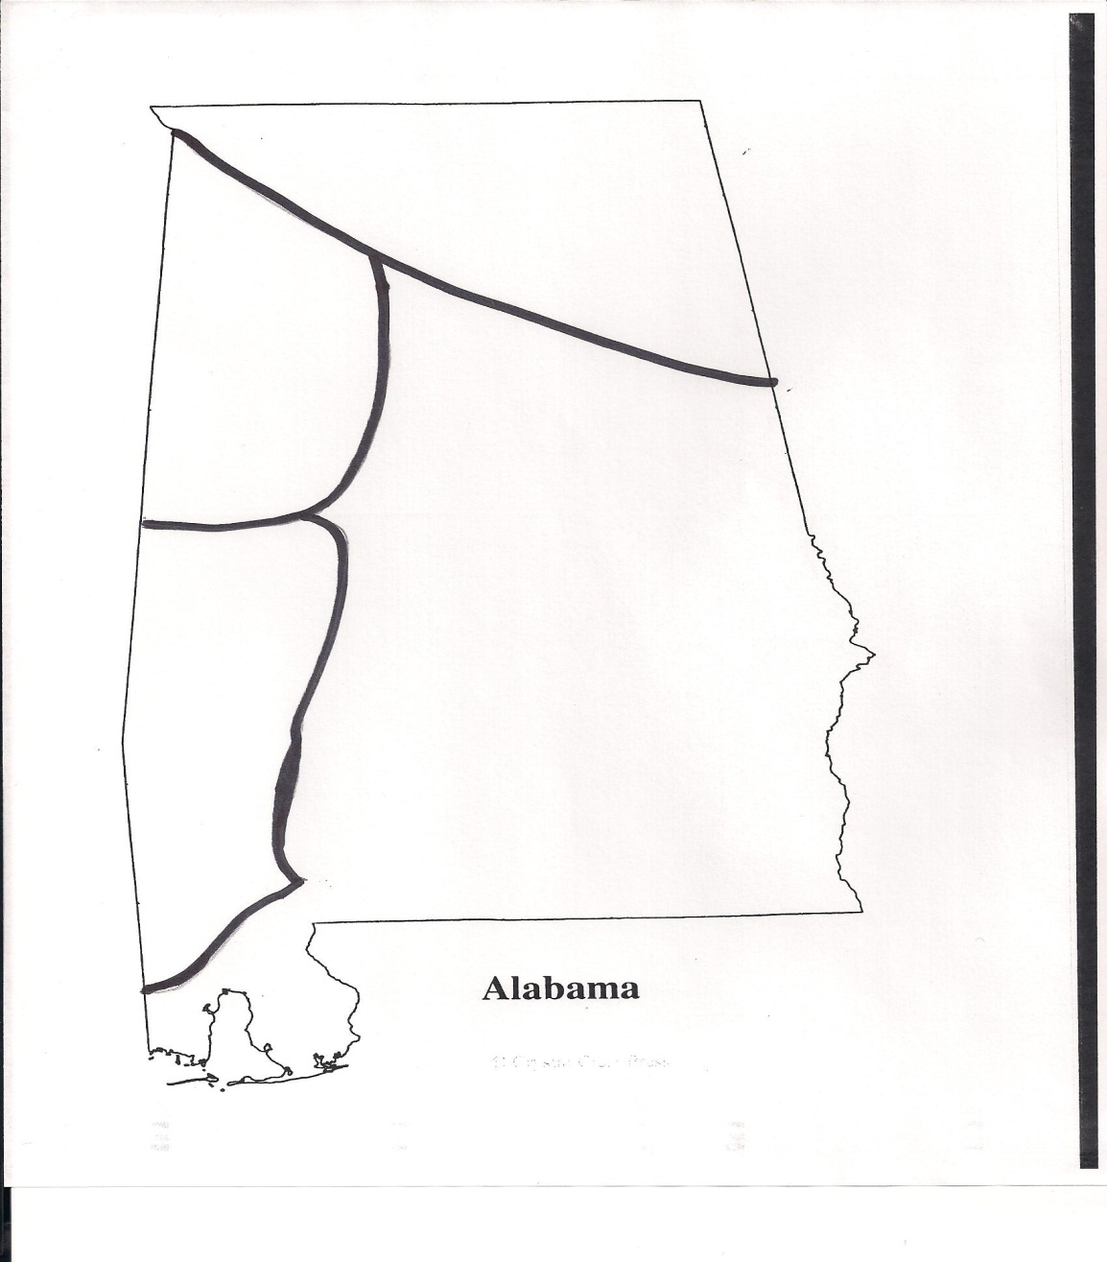
Guess the Indian Territory
Creek
Chickasaw
Choctaw
Cherokee
Cherokee
Chickasaw
Creek
Choctaw

Slide 4
Way to Go!!!!!
Thanks for Playing!!!

